Slide 1
Image Processing 4
2019-5-29

Slide 2
Compare(ordinary images):
The Electromagnetic Spectrum : visible(red, green, blue), infrared and ultraviolet are descriptive regions in it.
Bumble bees see ultraviolet (10nm to 380nm)
Humans see visible light (380nm to 700nm)
Goldfish see infrared (700nm to 1mm)
Multispectral and hyperspectral images gives the power to see as humans, goldfish and bumble bees.
Advantage: 1.more ubiquitous 2.higher spatial resolution 3.wider range of frequencies

Slide 3
Remote sensing image:
Remote sensing is the science of obtaining information about objects or areas from a distance, typically from aircraft or satellites.
Remote sensors collect data by detecting the energy that is reflected from Earth. These sensors can be on satellites or mounted on aircraft.
Passive sensors: respond to external stimuli. They record natural energy that is reflected or emitted from the Earth’s surface. The most common source of radiation detected by passive sensors is reflected sunlight.
Active sensors: use internal stimuli to collect data about Earth.

Slide 4
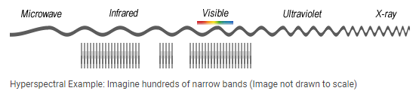
Hyperpectral images 1:
Hyperpectral imaging combines the power of digital and spectroscopy.
Focus on how narrow the bands are
It consists of much narrower bands(10-20nm). A hyperspectral image could have hundreds or thousands of bands. In general, it comes from an imaging spectrometer.

Slide 5
Hyperpectral images 2:
Advantage:
With high spectral resolution and many bands, it can acquire almost continuous spectral characteristic curves of ground objects, and can select or extract specific bands according to needs to highlight target features
All the same spatial resolution, the spectral coverage is wider, and it is possible to detect more response characteristics of the ground object to electromagnetic waves.
More bands, which facilitates mutual correction between bands.
Disadvantage:
The amount of data is large, the image contains dozens to hundreds of bands, and the data volume is several hundred times of the single-band remote sensing image; the data has a lot of redundancy, and the processing is improper, which will affect the classification accuracy
There are many bands and high correlations between the bands. Therefore, the number of training samples required for classification is greatly increased, and the training parameters obtained due to insufficient training samples are often unreliable(dimensional disaster)

Slide 6
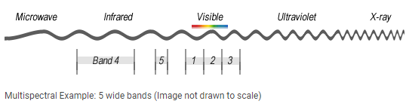
Multispectral images:
Multispectral imaging combines the power of digital and spectroscopy.
The number of bands
It generally refers to 3 to 10 bands. To be clear, each band is obtained using a remote sensing radiometer.

Slide 7
SAR(Synthetic Aperture Radar) images:
Synthetic-aperture radar is an Earth observation technology which takes pictures of both land and sea, without the need for sunlight or the need for clear skies.
While optical cameras rely on light created by other sources, like the sun, a radar instrument actively send its own radio waves towards its target and then measures what is reflected back.
To create a SAR image, successive pulses of radio waves are transmitted to "illuminate" a target scene, and the echo of each pulse is received and recorded. The pulses are transmitted and the echoes received using a single beam-forming antenna, with wavelengths of a meter down to several millimeters. As the SAR device on board the aircraft or spacecraft moves, the antenna location relative to the target changes with time. Signal processing of the successive recorded radar echoes allows the combining of the recordings from these multiple antenna positions. This process forms the synthetic antenna aperture and allows the creation of higher-resolution images than would otherwise be possible with a given physical antenna

Slide 8
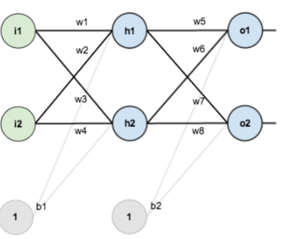



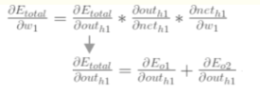

Backpropagation:
Calculate Square Error:
Hidden layer->Update the output layer’s weight
For example: w5 -> chain rule
From this, we can know how much influence w5 has on the square error.
Update w5: (n is learning rate)
Out(o1)->net(o1)->w5
Hidden layer->Update the hidden layer’ s weight
Update w1:
Out(h1)->net(h1)->w1

Slide 9
Loss function:
It’s a method of evaluating how well your algorithm models your dataset. If your predictions are totally off, your loss function will output a higher number. If they’re pretty good, it’ll output a lower number. As you change pieces of your algorithm to try and improve your model, your loss function will tell you if you’re getting anywhere.
It can be divided into two categories: classification and regression

Slide 10
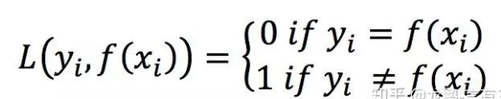
Loss Function(classification): 0-1 loss
Loss is 0 when the tag is equal to the predicted category, otherwise it is 1. It can be seen that 0-1 loss cannot derivate x, which cannot be used in deep learning tasks that rely on backpropagation. 0-1 loss is more inspiring the generation of new loss.

Slide 11

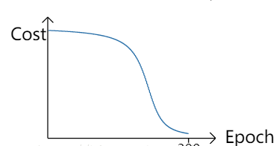

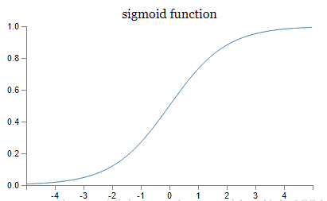
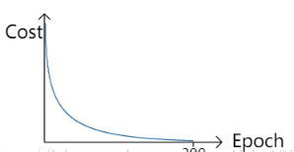
Logarithmic loss:
0-positive
1-negative

Slide 12

Softmax loss:
1. When the input is X, the probability that the prediction category is j is P.
2. All prediction categories have a probability of 1
There is a significant correlation between prediction results and input characteristics

Slide 13

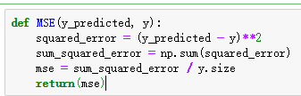
Loss function(regression): Mean squared Error
It is the workhorse of basic loss functions
Easy to understand and implement and generally works pretty well

Slide 14

MAE(Mean absolute loss):

Slide 15
Prevent the Gradient Vanish in CNN:
Deep network
Inappropriate loss function

Slide 16
1. Pre-training and fine-tunning
Pre-training: Each time a layer of hidden nodes is trained, the output of the hidden layer of the previous layer is taken as input, and the output of the hidden node of this layer is used as the input of the hidden node of the next layer.
After the pre-training is completed, the entire network is "fine-tuned”
After the pre-training of each layer is completed, the BP algorithm is used to train the entire network. This idea is equivalent to first finding the local optimum and then integrating it to find the global optimal.

Slide 17
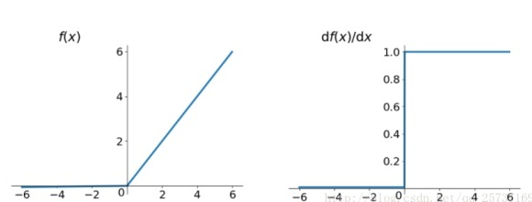
2. Relu, Leakrelu, elu and other activation functions
The derivative is constant at a positive
number equal to 1 and does not cause a
gradient
Disappearing and exploding Problems
Main contribution:
Solved the problem of gradient disappearance and explosion
Easy to calculate, fast
Speed ​​up network training
Disadvantages:
Negative numbers are always 0, which will cause some neurons to be inactive (can be set to solve the small learning rate)

Slide 18


3. Batchnorm(batch normalization):
In forward propagation ,then in backpropagation , there is the existence of w in the backpropagation equation, so the size affects the disappearance and explosion of the gradient, and batchnorm is the method of scale and shift by outputting the output of each layer. Through a certain standardization method, the distribution of the input value of any neuron in each layer of the neural network is forcibly pulled back to the standard positive distribution with a mean value of 0 and the variance is 1. The severely deviated distribution forcibly pulls back the standard distribution, thus The activation input value falls in the region where the nonlinear function is sensitive to the input, so that small changes in the input will result in a large change in the loss function, making the gradient larger, avoiding the gradient disappearance problem, and increasing the gradient means learning convergence Fast speed can greatly speed up training.

Slide 19
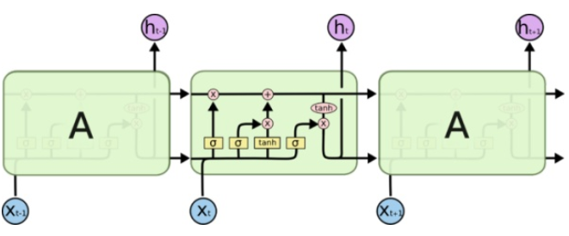
4. LSTM (long-short term memory networks):
Time modeling
Its output depends not only on the information that the left node gives him, but also on the state and output of the previous moment.

Slide 20
Tensorflow:
TensorFlow is an open source software library for numerical computation using data flow graphs. The graph nodes represent mathematical operations, while the graph edges represent the multidimensional data arrays (tensors) that flow between them. This flexible architecture enables you to deploy computation to one or more CPUs or GPUs in a desktop, server, or mobile device without rewriting code.
TensorFlow was originally developed by researchers and engineers working on the Google Brain team within Google's Machine Intelligence Research organization for the purposes of conducting machine learning and deep neural networks research. The system is general enough to be applicable in a wide variety of other domains, as well.

